Slide 1
Lecture 16
CTMC
Numerical Computation

Slide 2
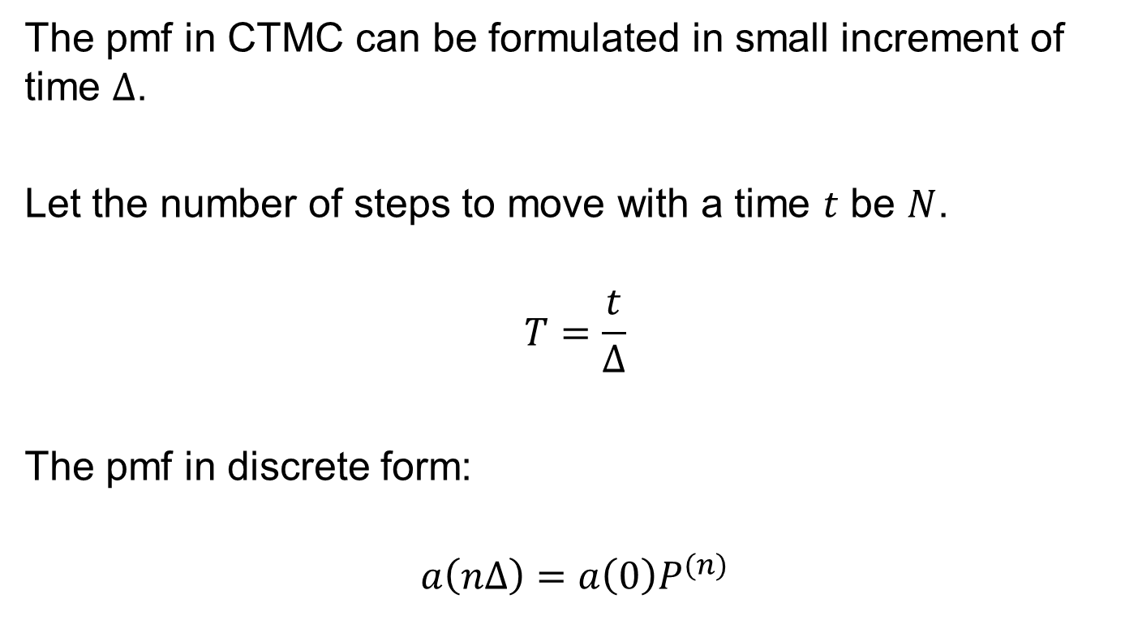

Numerical Computation of $P(t)$
The pmf in CTMC can be formulated in small increment of time $Δ$.
Let the number of steps to move with a time $t$ be $N$.
$$T=\frac{t}{Δ}$$
The pmf in discrete form:
$$a\left(nΔ\right)=a\left(0\right)P^{(n)}$$

Slide 3
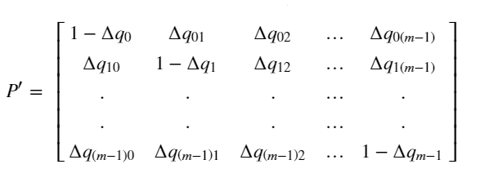
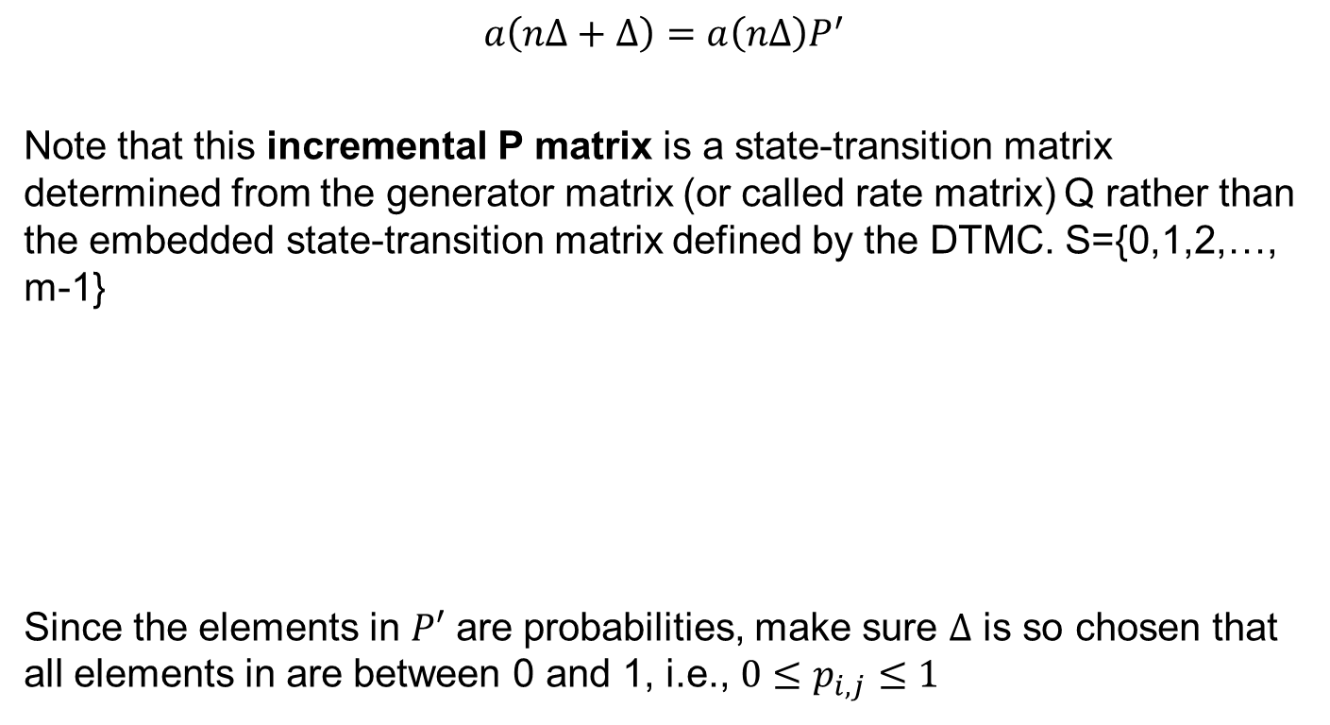

Incremental Matrix $P′$
$$a\left(nΔ+Δ\right)=a\left(nΔ\right)P^{′}$$
Note that this incremental P matrix is a state-transition matrix determined from the generator matrix (or called rate matrix) Q rather than the embedded state-transition matrix defined by the DTMC. S={0,1,2,…, m-1}
Since the elements in $P′$ are probabilities, make sure $Δ$ is so chosen that all elements in are between 0 and 1, i.e., $0≤p_{i,j}≤1$

Slide 4
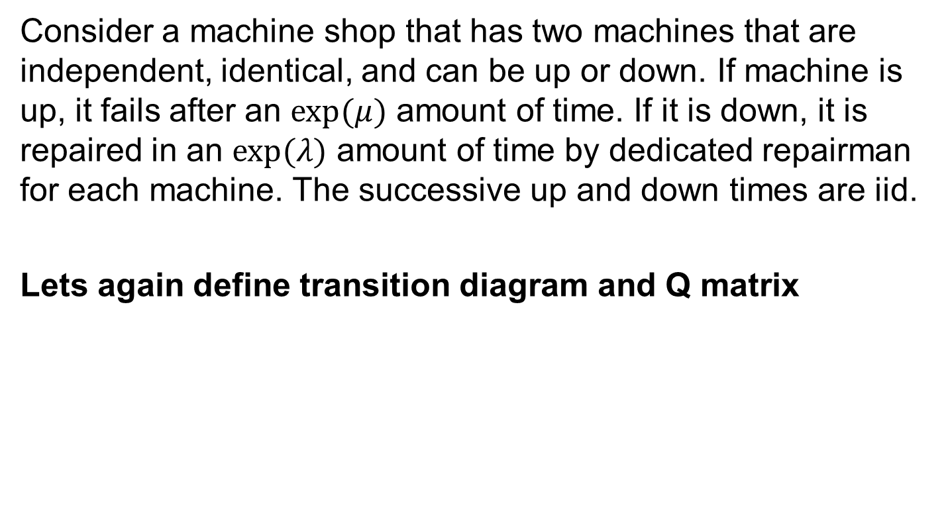
Two Machine Two Repair Crew
Consider a machine shop that has two machines that are independent, identical, and can be up or down. If machine is up, it fails after an $exp(μ)$ amount of time. If it is down, it is repaired in an $exp(λ)$ amount of time by dedicated repairman for each machine. The successive up and down times are iid.
Lets again define transition diagram and Q matrix

Slide 5
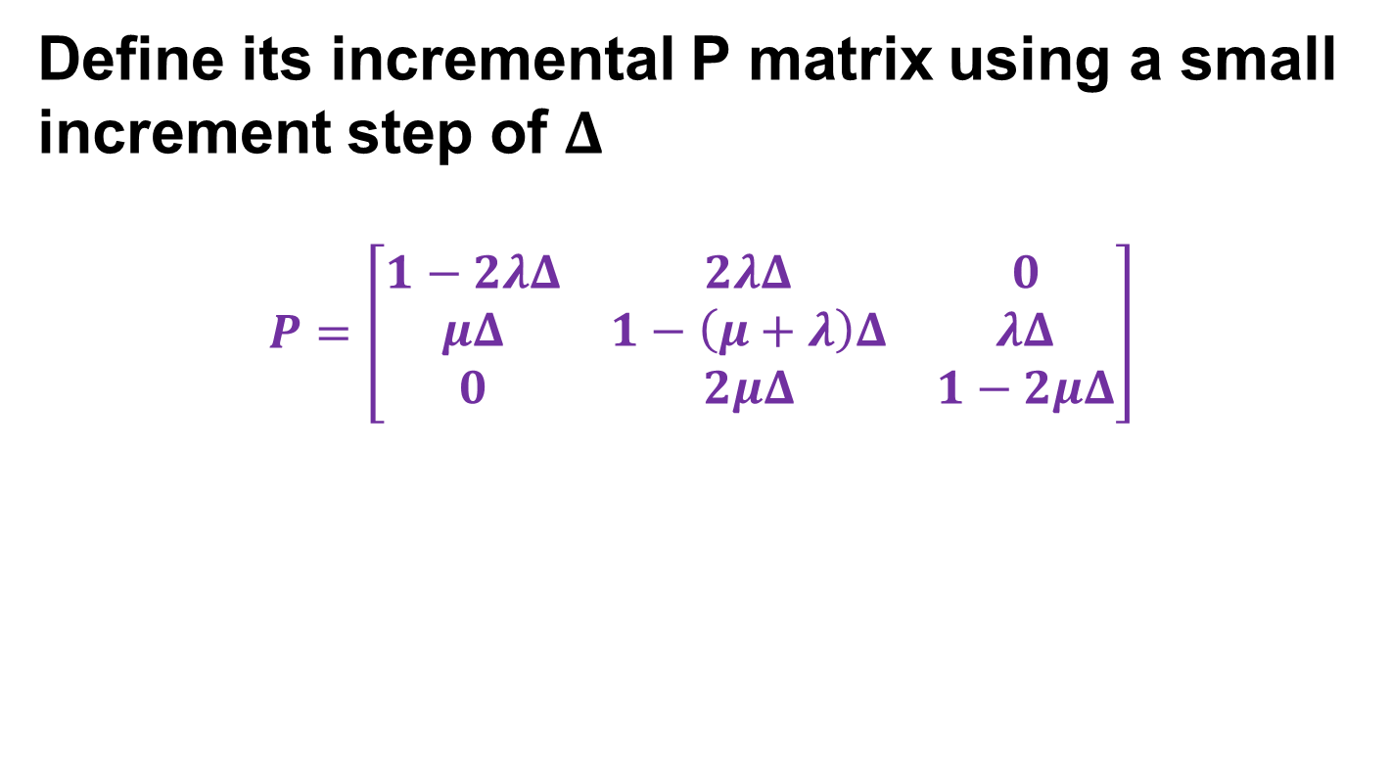
Two Machine Two Repair Crew
Define its incremental P matrix using a small increment step of $Δ$
$$P=\left[\begin{matrix}1−2λΔ & 2λΔ & 0 \\ μΔ & 1−\left(μ+λ\right)Δ & λΔ \\ 0 & 2μΔ & 1−2μΔ\end{matrix}\right]$$

Slide 6
Birth Death Process Example
Your Turn
ATM example. Five persons can be in the foyer of a bank ATM machine. Assume that customers won't enter when the foyer is full. Past data shows that the average time between arrival is 30 seconds where the average service time is 24 seconds. First, let's model it as a birth and death CTMC. Can we write the increment matrix (some elements only)

